Slide 1


Final Report: Yelp Dataset Analysis
STAT 628 Group 9: Yezhou Li, Chushi Shi, Fangfei Lin, Lu Chen

Slide 2
Outline
U-Dar: Top User Based Recommendation System
User to Business Network
User to User Network
Tastes of Influencer
Natural Language Processing
Sentiment Analysis
Prediction

Slide 3
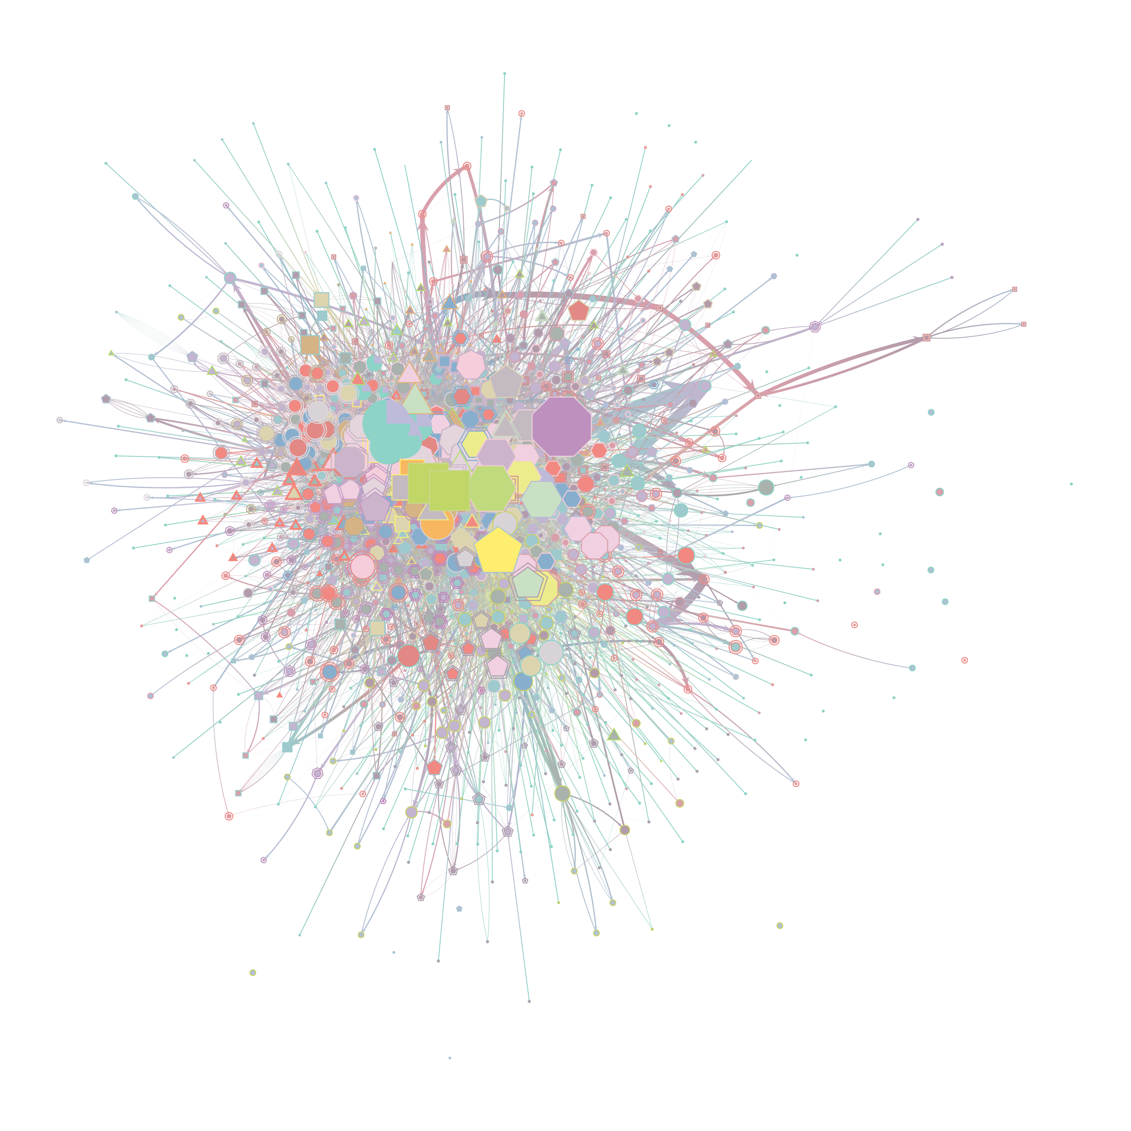
U2B Network
Node: Users & Business
Users: 51, 702
Business: 3, 172
Relationships:
User → User : 2, 154, 095
*User → Business : 177, 500

Slide 4
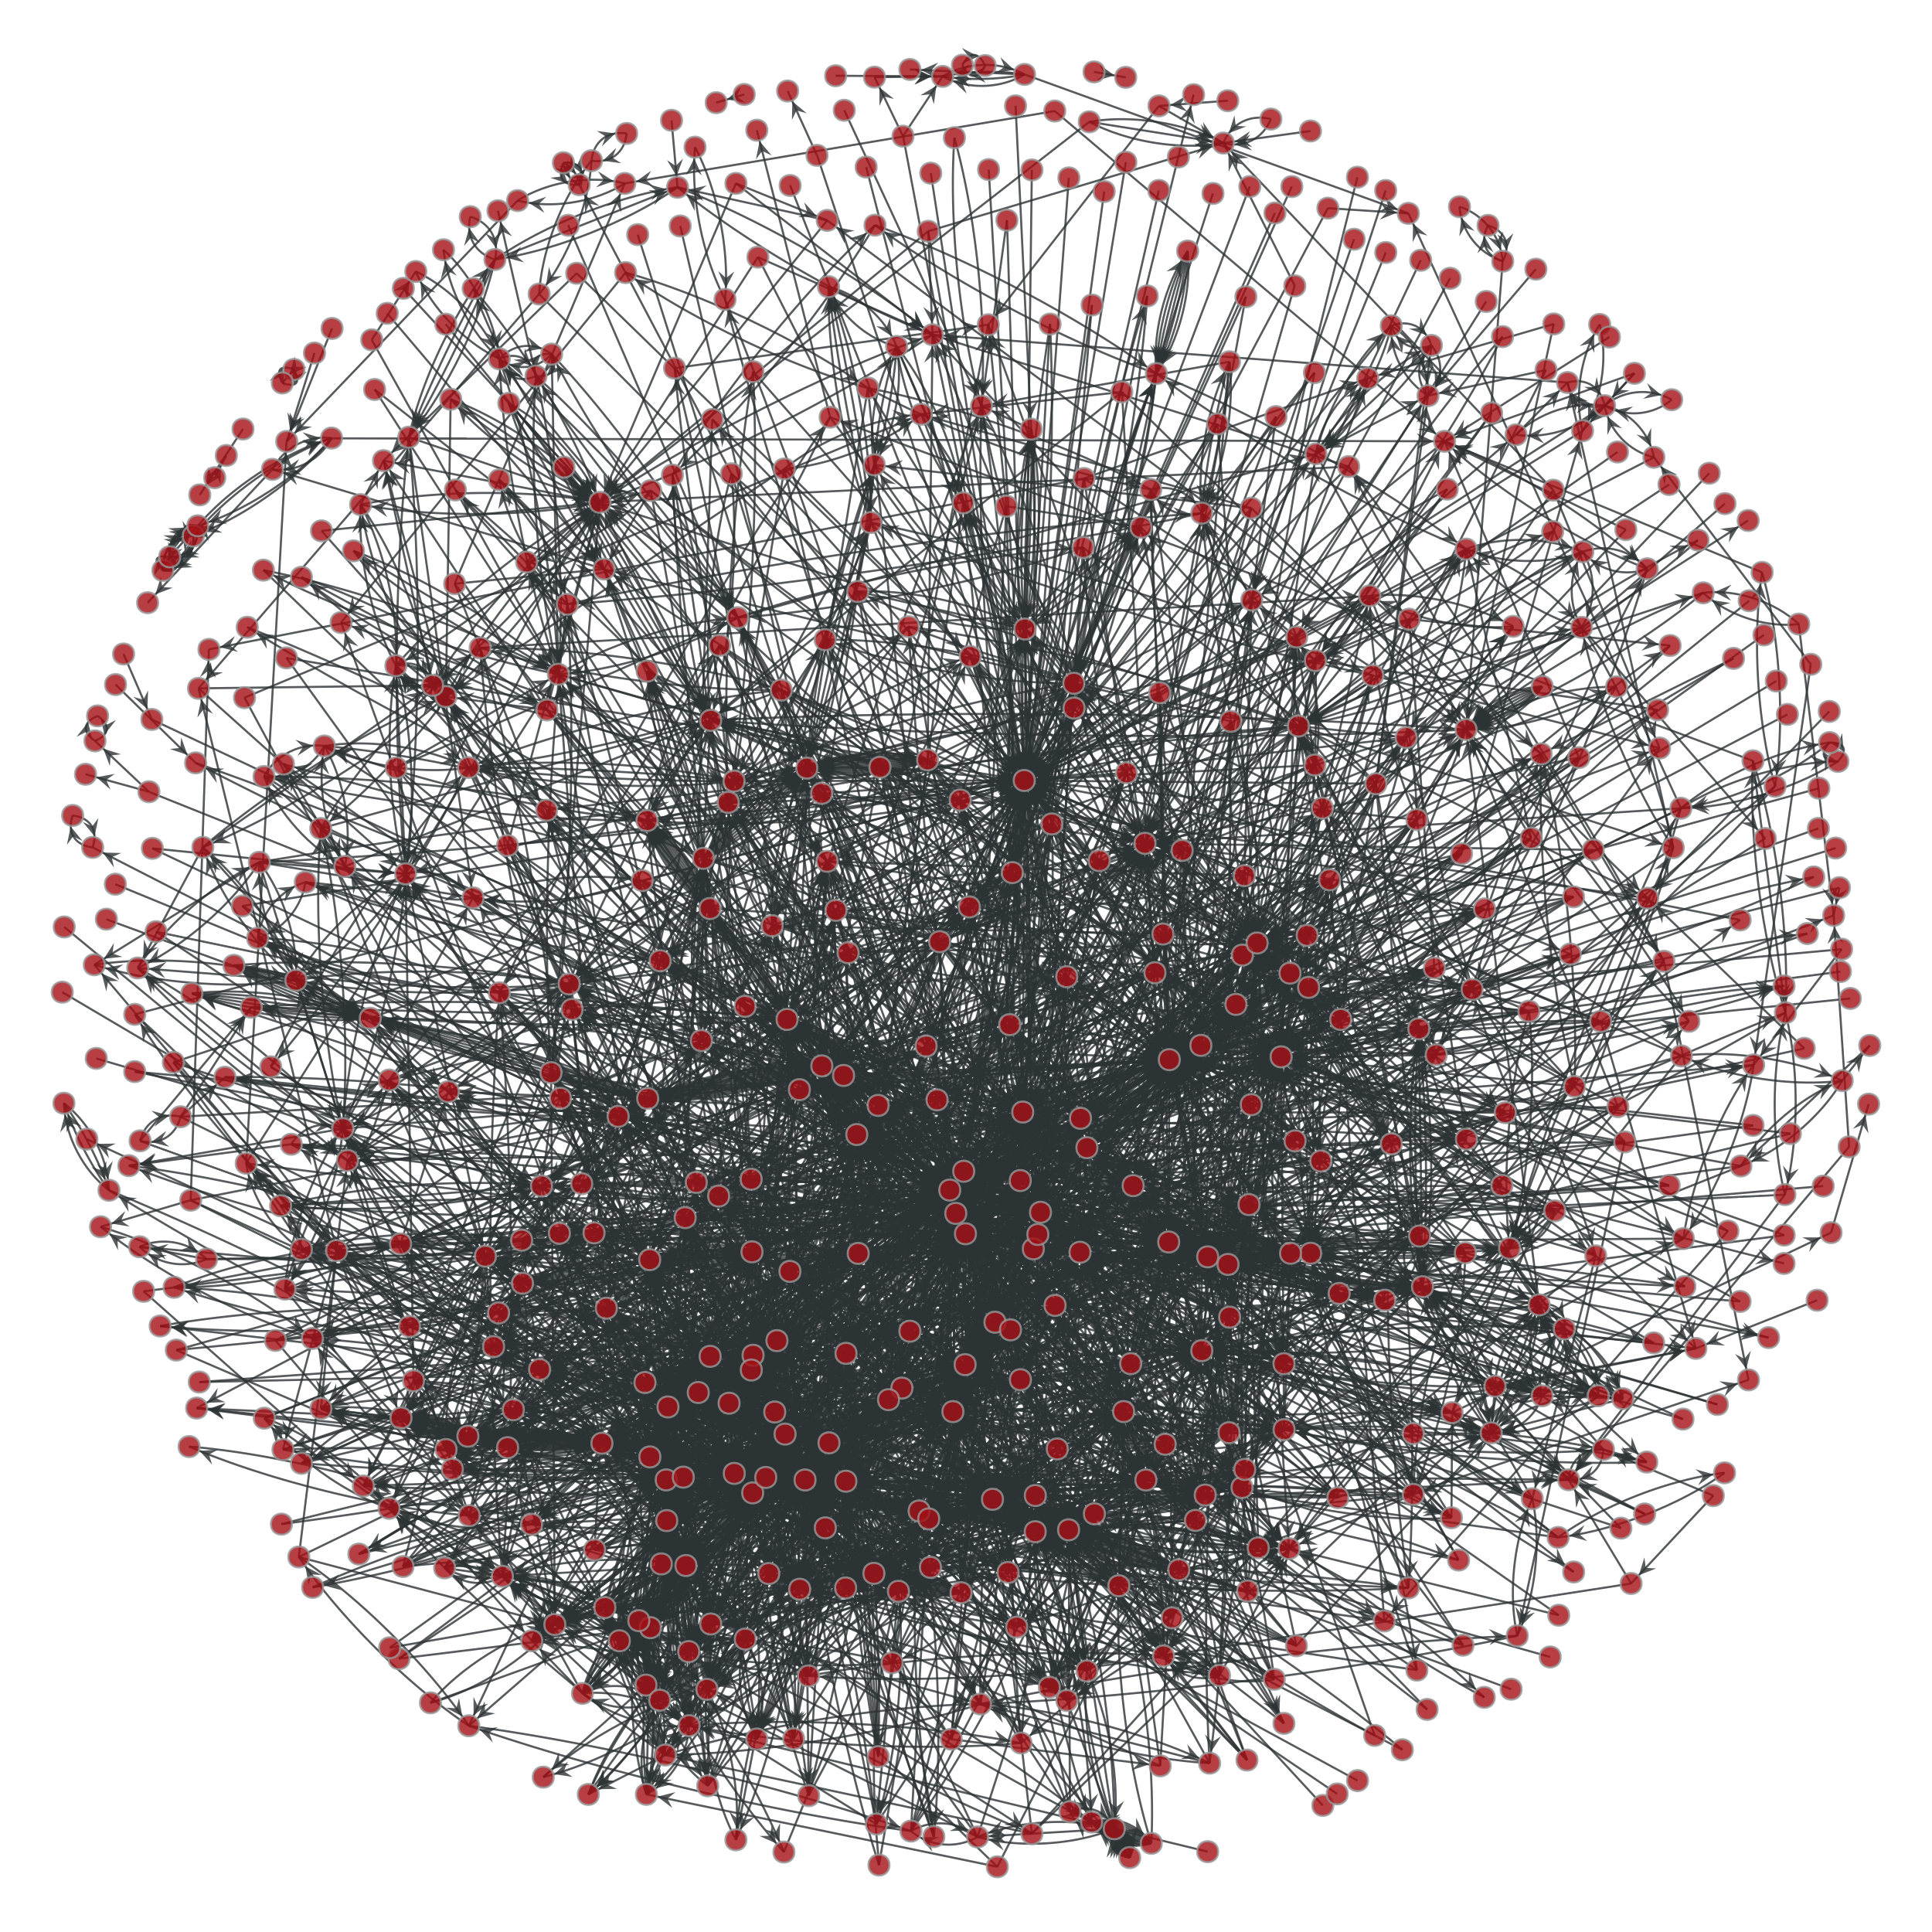
U2U Network
Power Influencer: Top100 Users under PageRank
Relationships:
Follower → Influencer : 167, 624
User → User : 269, 969

Slide 5
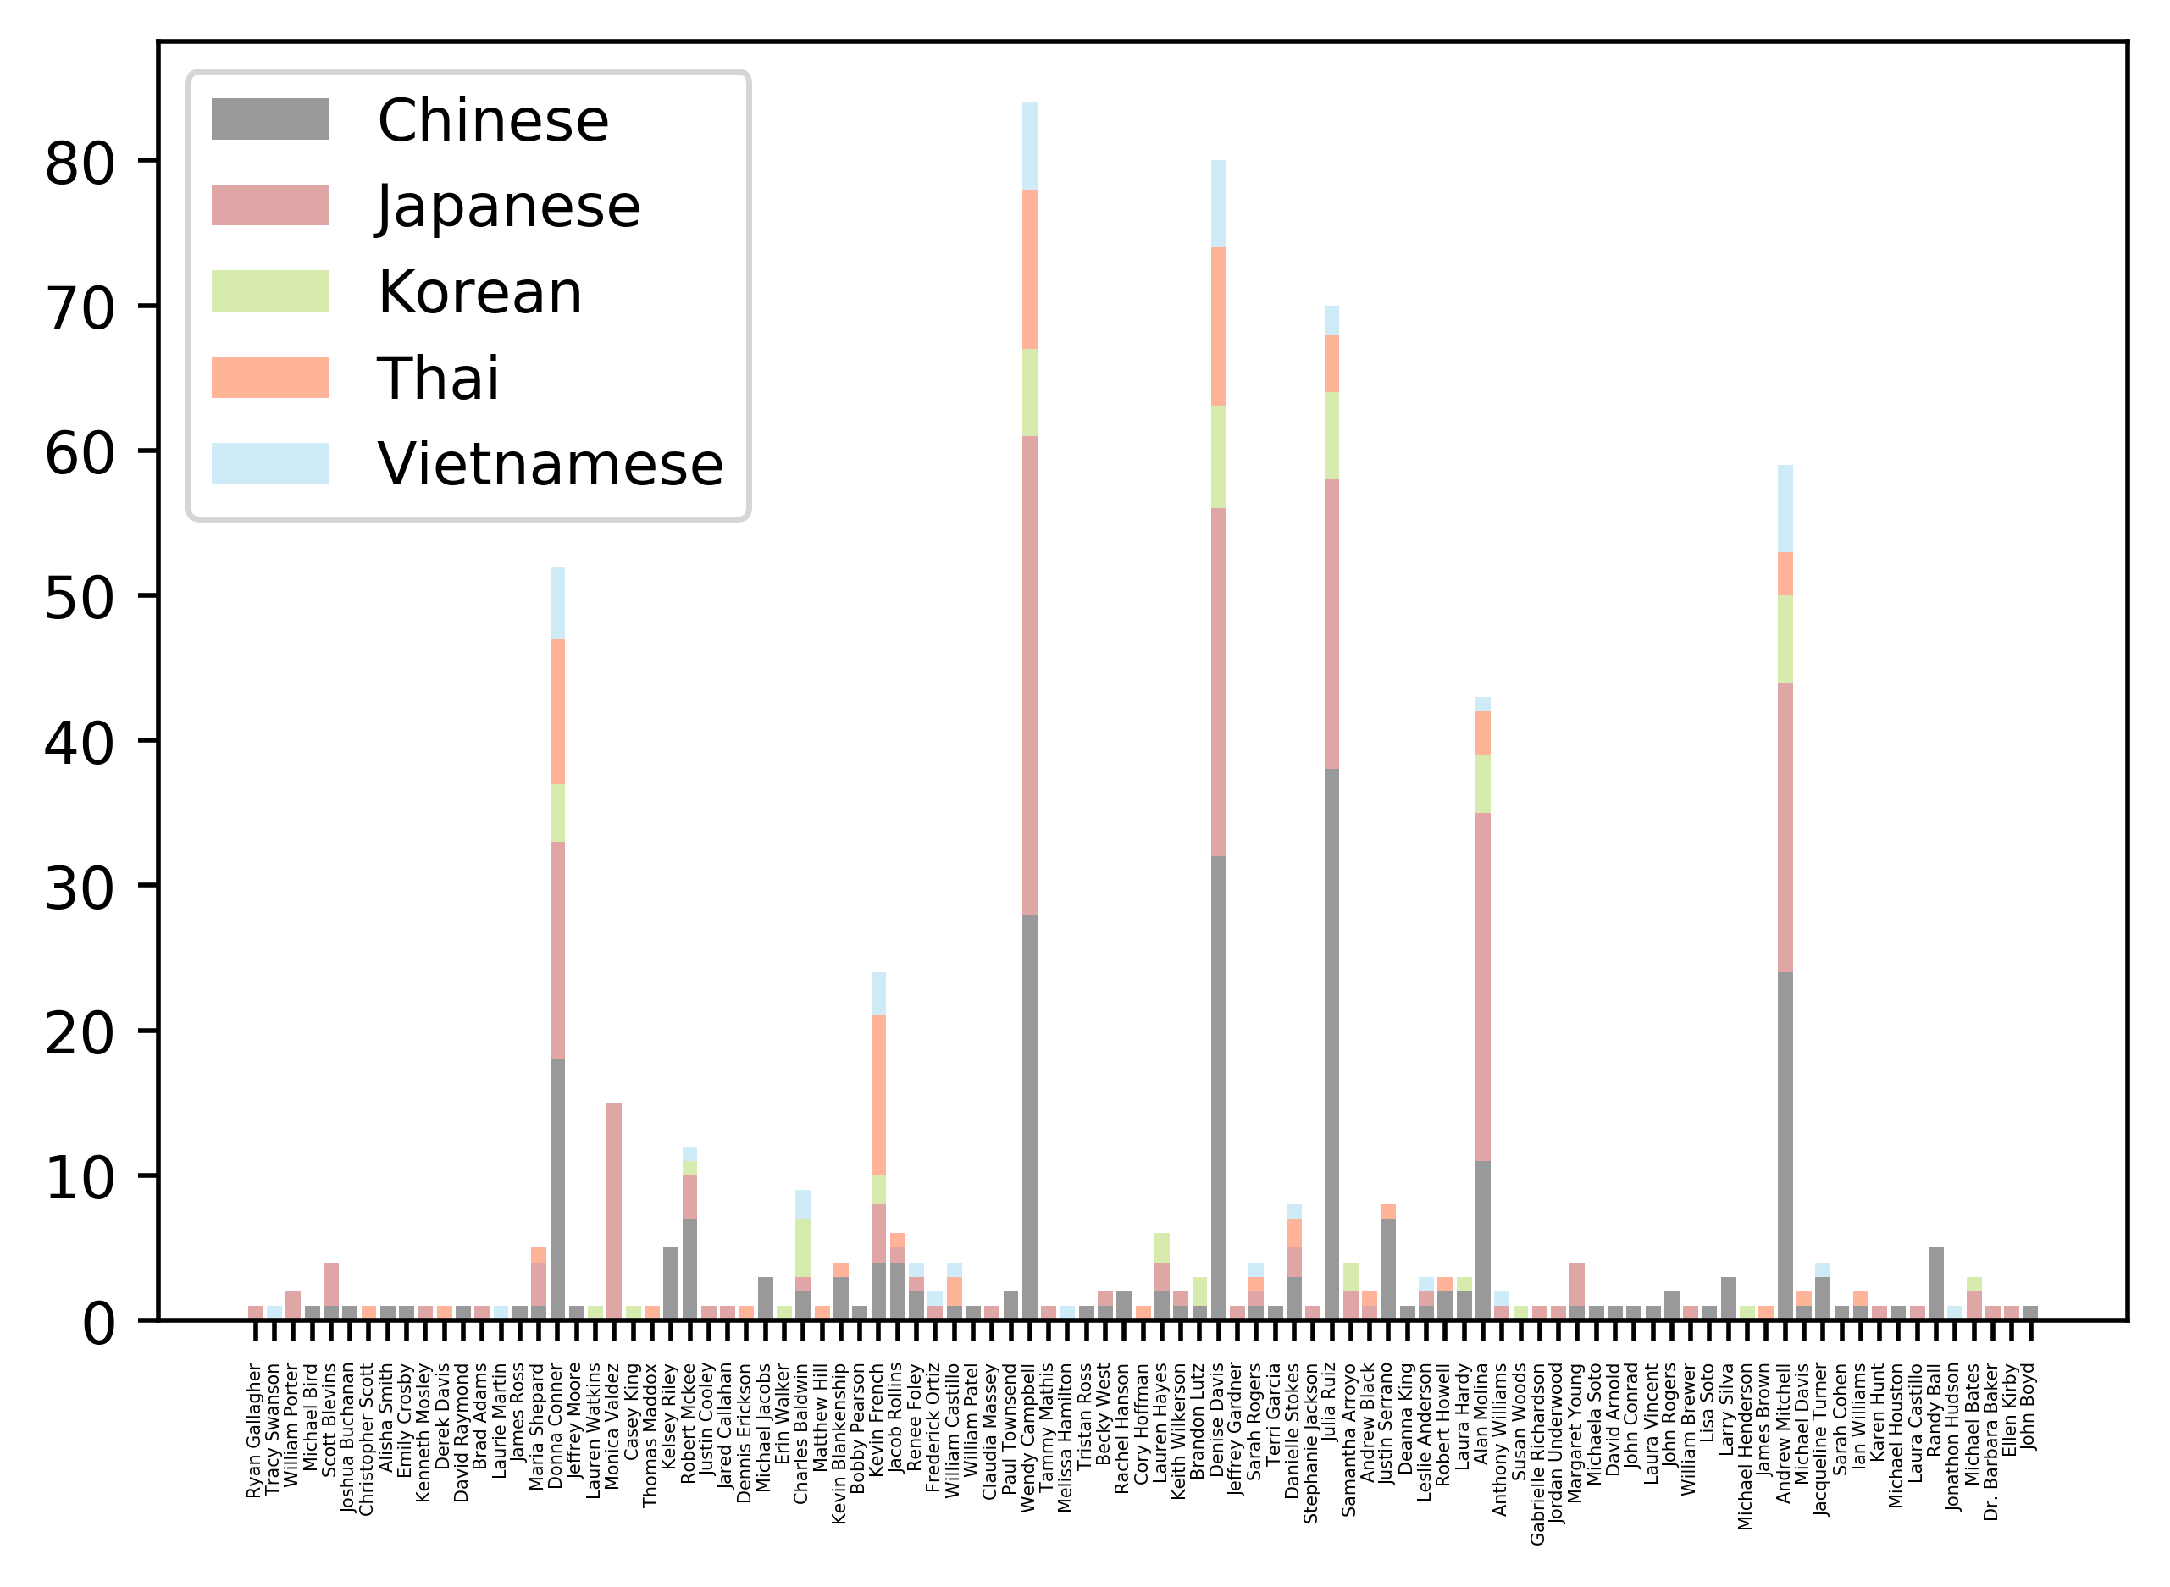
Tastes of Influencer
Main Label
Category Label
Star User

Slide 6
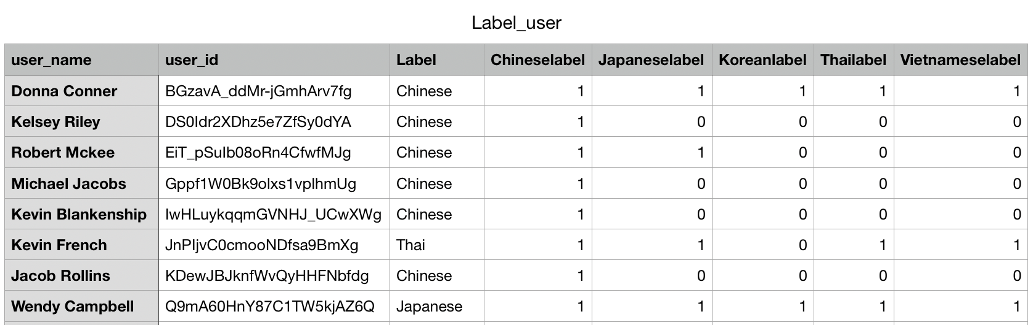
Tastes of Influencer

Slide 7
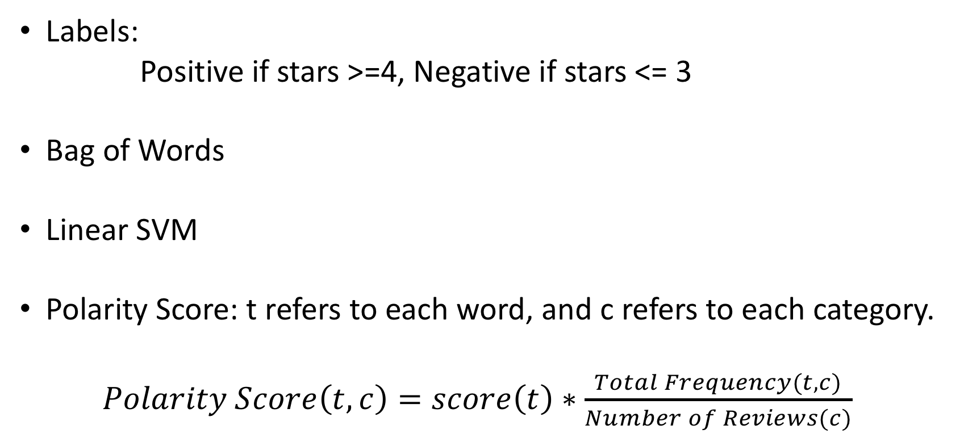
Sentiment Analysis: Methods
Labels:
Positive if stars >=4, Negative if stars <= 3
Bag of Words
Linear SVM
Polarity Score: t refers to each word, and c refers to each category.
$Polarity Score\left(t,c\right)=score\left(t\right)∗\frac{Total Frequency(t,c)}{Number of Reviews(c)}$

Slide 8
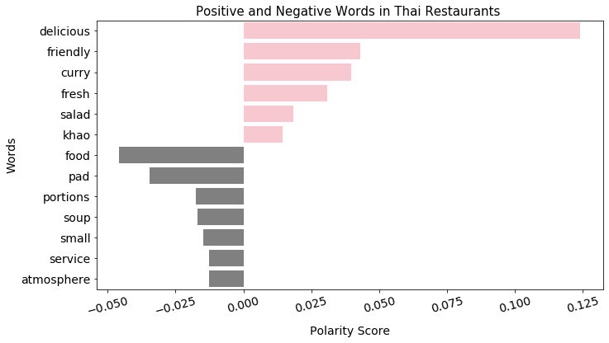
Example: Thai Restaurants

Slide 9
Shiny App
Link:
https://yezoli.shinyapps.io/Yelp-Business-Analysis/

Slide 10
Thank YOU!

